Slide 1

Internet Programming I
Chapter 4
JavaScript: Presentation Topic
Group:
3rd Year Sec X Students,
Dept. of Software Eng.
Jan 2022, AASTU

Slide 2

Objectives
After success completion of the session you will be able to:
Differentiate client side and server scripting language.

Slide 3
Outline
Main Topic
Sub topics

Slide 4
1. The 1st topic goes here
The W3C DOM standard is separated into 3 different parts:
Core DOM - standard model for all document types

Slide 5
Practical Exercises
What happens

Slide 6
Reading Resources/Materials
Chapter X (if you used text book)
Jon Duckett; HTML and CSS Design and Build Websites, 2011 John Wiley & Sons, Inc., Indianapolis, Indiana
Links
Paul Deitel,

Slide 7
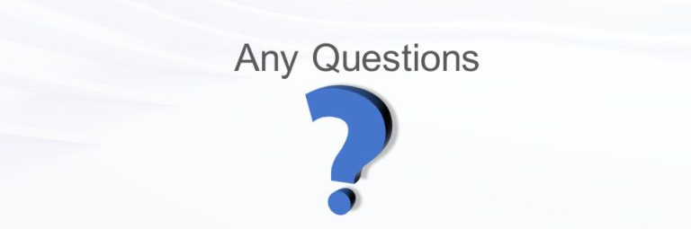
Thank You
For Your Attention!!

